Slide 1
Gender, Race, & Income: Influence on Political Affiliation
Virthiha S., Cordelia T., Dylan H.

Slide 2
Introduction
Subject:
This research examines the correlation of demographic factors, specifically gender, race, and income, on political affiliation in the United States. The focus is on understanding how various factors influence whether individuals identify as Democrats or Republicans, in the context of our country’s growing political polarization.
Motivation:
As political divisions in the U.S. intensify, it is essential to explore the underlying demographic correlations on political affiliation. Understanding how gender, race, and income shape political identity, voting behaviors, and party loyalty can offer insights that are crucial for predicting future voting patterns, informing political campaigns, and guiding policy decisions.
Research Question:
How do gender, race, and income correlate with political affiliation (Democrat vs. Republican) in the United States?

Slide 3
Data Set + Variables
We used the 2020 American National Election Study Time Series Data set. After cleaning, analytical a sample contained 5,772 respondents and 12 variables.
Party_dem: coded 1 if a respondent leaned more Democrat (party ID categories 1-3) and 0 if they leaned Republican (categories 5-7). Pure independents and missing values were coded N/A.
Category | Code
Gender | 1 = female, 0 = male
Race | 1 = white, 0 = non-white
Income3, inc_sum | 3 categories (Low, Medium, High),
educ5 | 5 categories (higher values = more education)
ideology7 | 7 categories, self placement (1 = extremely liberal, 7 extremely conservative)

Slide 4
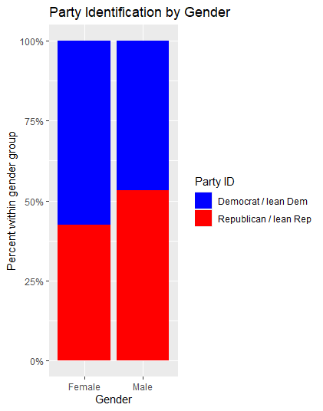
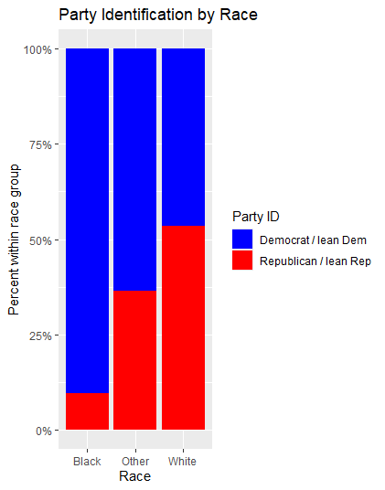
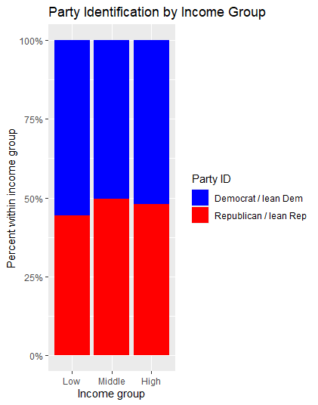
Highlights from the descriptive statistics

Slide 5
Results
Regression Model
Estimate | P-value
Start: 1.440 | 0
Female: 0.029 | 7.89*10^-4
White: -0.195 | 4*10^-53
Num Inc Cat: -0.002 | 0.0193
Age: -0.009 | 1.48*10^-5
5- lvl Educ.: 0.007 | 0.121
7-pt. Ideology: -0.214 | 0
H1 - Gender | H2 - Race
Women: 57.6% Dem. | Non-White: 71.6% Dem.
Men: 57.6% Dem. | White: 46.6% Dem.
P-value: 7.7 * 10^-17 | P-value: 3.5 * 10^-84
H1 is strongly supported. | H2 is strongly supported.
H3 - Income
Low: 55.7% Dem.
Middle: 50.5% Dem.
High: 52.1%
ANOVA P-value: 0.00812
H3 is supported but weaker.

Slide 6
Next Steps
Continue working on our final report
Do the results feel intuitive, or are any findings surprising/confusing?
What would make the conclusions more compelling or actionable?

